Slide 1
Post-translational modifications
By
Ram Balak Mahto
Guest faculty
Zoology department
V.S.J College Rajnagar Madhubani
B.Sc 2nd yr gen/sub

Slide 2
Post-translational modifications
Many newly-synthesized proteins are functionally inactive
They require some modifications in their structure before they become active
These modifications are known as post- translational modifications

Slide 3
Common post-translational modifications are:
Cleavage
Hydroxylation
Carboxylation
Phosphorylation
Glycosylation
Addition of other prosthetic groups

Slide 4
Cleavage
The nascent protein may contain some extra amino acids which are removed
An example is removal of connecting peptide from proinsulin to form insulin

Slide 5
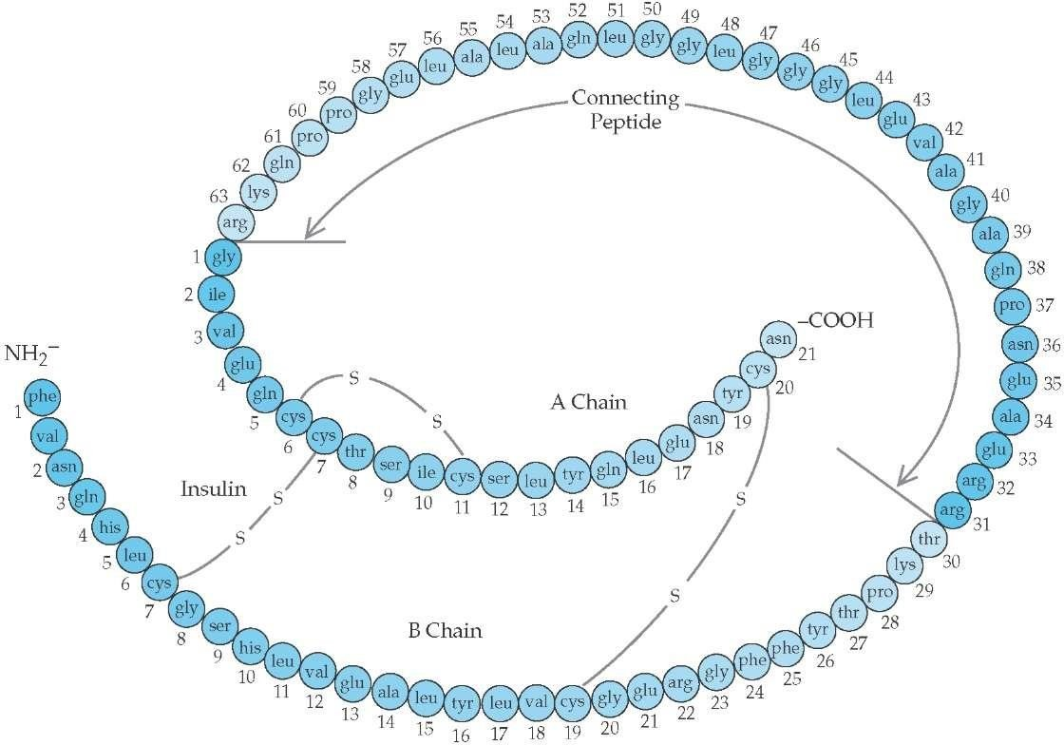
Connecting peptide
A Chain
B Chain
Proinsulin

Slide 6
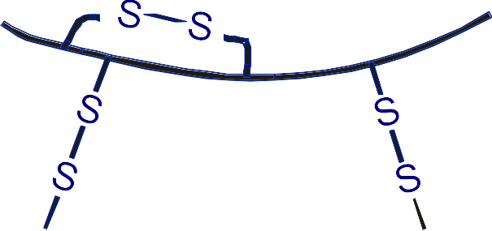
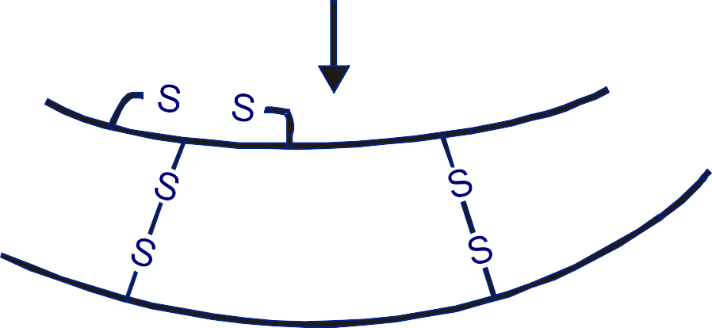
COOH
H₂N
Proinsulin
A-chain
B-chain
Insulin

Slide 7
pro-
Another example of cleavage is opio-melano-cortin (POMC)
Alternative cleavage eight different peptides
of POMC
yields

Slide 8
Hydroxylation
Some amino acid residues, e.g. proline and lysine, may be hydroxylated after translation
Hydroxylation of proline and lysine residues is important in the conversion of pro-collagen into collagen

Slide 9
Carboxylation
Glutamate residues of pre-prothrombin are carboxylated after translation
This converts pre-prothrombin into prothrombin
Glutamate residues of several other proteins are also carboxylated

Slide 10
Phosphorylation
Serine, threonine and tyrosine residues of some proteins can be phosphorylated
Phosphorylation is a method used for regulating the activity of some enzymes
Phosphorylation of tyrosine residues is important in intracellular signaling

Slide 11
Glycosylation
Carbohydrate prosthetic added to many proteins
groups are
Examples hCG etc
are mucin,
immunoglobulins,
These can form O-linked, N-linked and GPI-linked glycoproteins

Slide 12
The linkage between carbohydrate portion and protein occurs through:
Hydroxyl group of serine in O-linked glycoproteins
Amide group of asparagine in N-linked glycoproteins
Phosphatidyl inositol in GPI-linked glycoproteins

Slide 13
Addition of other prosthetic groups
Several other groups are added to proteins after translation e.g.
Haem Flavin nucleotides
Biotin Retinal Metals

